Slide 1
Credit Card Fraud Detection
- using Machine Learning Algorithm

Slide 2
FRAUD DETECTION
The online shopping growing day to day. Credit cards are used for purchasing goods and services with the help of virtual card and physical card where as virtual card for online transaction and physical card for offline transaction.
Fraud detection refers to detection of criminal activities occurring in commercial organizations.
Malicious users might be the actual customers of organization or might be posing as a customer (also known as identity theft).
Credit card fraud detection technic used to recognize fraudulent credit card transactions so that customers are not charged for items that they did not purchases.

Slide 3
ABSTRACT
Due to cashless Transaction every people use ATM card and credit card transaction, so fraud can also be increase.
Billions of dollars of loss are caused every year by fraudulent credit card transaction. The design of efficient fraud detection algorithms is key for reducing these losses and more and more algorithms rely on advanced machine learning techniques to assist fraud investigators.

Slide 4
TYPES OF FRAUD
Counterfeit credit cards
Lost or stolen cards
Card not present (CNP) fraud
Phishing
Non-receipt fraud
Identity theft fraud

Slide 5
TECHNOLOGY USED
Machine Learning
Machine learning is the scientific study of algorithms and static models that computer system use in order to perform a specific task effectively, without using the explicit instruction, relaying on patterns and interface instead.
Machine learning algorithm built a mathematical model based on sample data, known as training data in order to make prediction and decisions.
Machine learning algorithms are used in email filtering, face recognition, etc.

Slide 6
TECHNOLOGY USED
Supervised Learning
Supervised learning as the name indicates the presence of a supervisor as a teacher.
Supervised learning algorithm built a mathematical model of a set of data that contain both input and output.
Basically supervised learning is a learning in which we teach or train the machine using data which is well labeled that means some data is already with the correct answer.
After that, the machine is provided with a new set of examples so that supervised learning algorithm analyses the training data and produces a correct outcome from labeled data.

Slide 7
DATASET
The dataset that is used for credit card fraud detection is derived from the kaggle.
Kaggle is the online community of data scientist and Machine learners.
Kaggle allows users to find and publish data sets, explore and build models in a web based data science project and solve challenges.
This dataset presents transactions that occurred in two days, where we have 492 frauds out of 284,807 transactions. The dataset is highly unbalanced, the positive class (frauds) account for 0.172% of all transactions.
Dataset which we have downloaded from kaggle, is in csv format.

Slide 8
OBJECTIVES
To understand dataset
Implement preprocessing on dataset if necessary
To apply various algorithms on dataset
Finding out the best model
To predict if the transaction is legit or fraudulent, hence to prevent unauthorized financial activity by identifying transactions

Slide 9
DATASET DESCRIPTION
The Dataset is of classification type as output variable is discrete value.
Dataset contains 284807 rows and 31 columns.
There are no missing values (null) in dataset.
In this dataset, all features are in float data type.
Class is an output variable/Label, which notifies whether the transaction is legit (0) or fraudulent (1) and in this dataset we can see huge data imbalance.

Slide 10
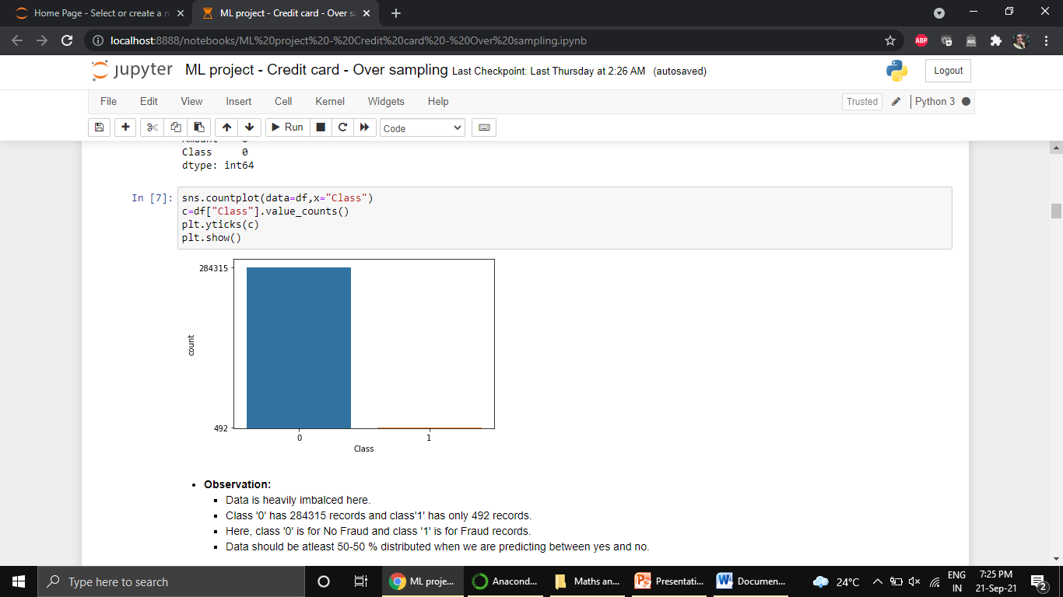
DATASET DESCRIPTION
Data is heavily imbalanced here.
Class ‘0’ has 284315 records where class ‘1’ has only 492 records.

Slide 11
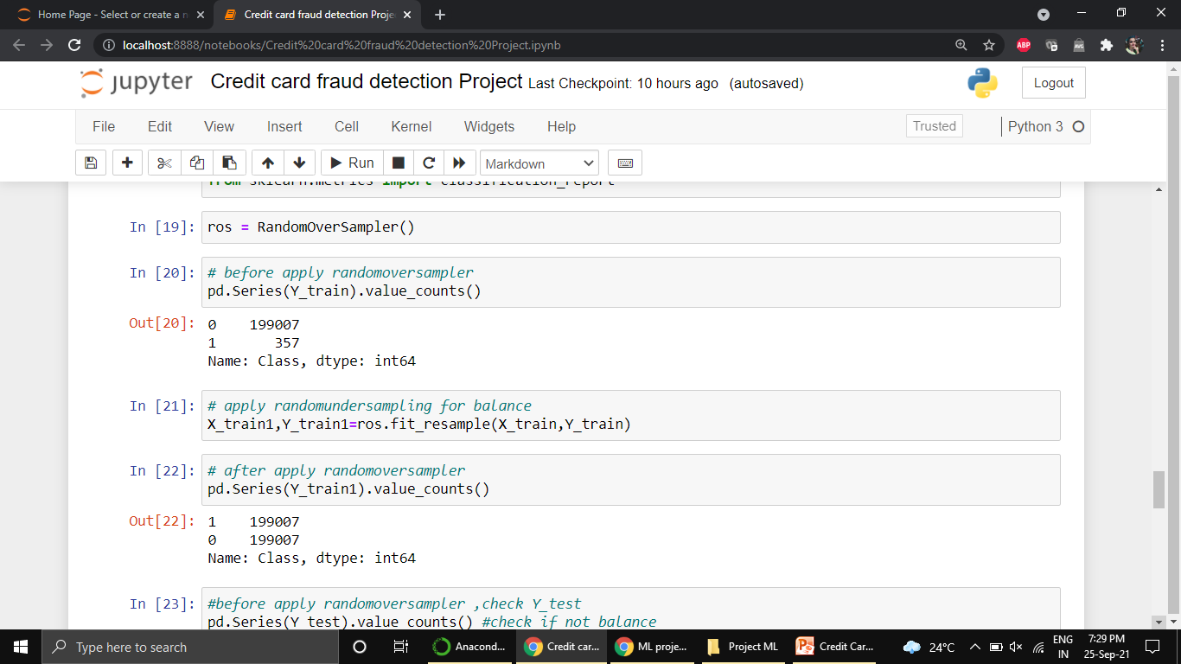
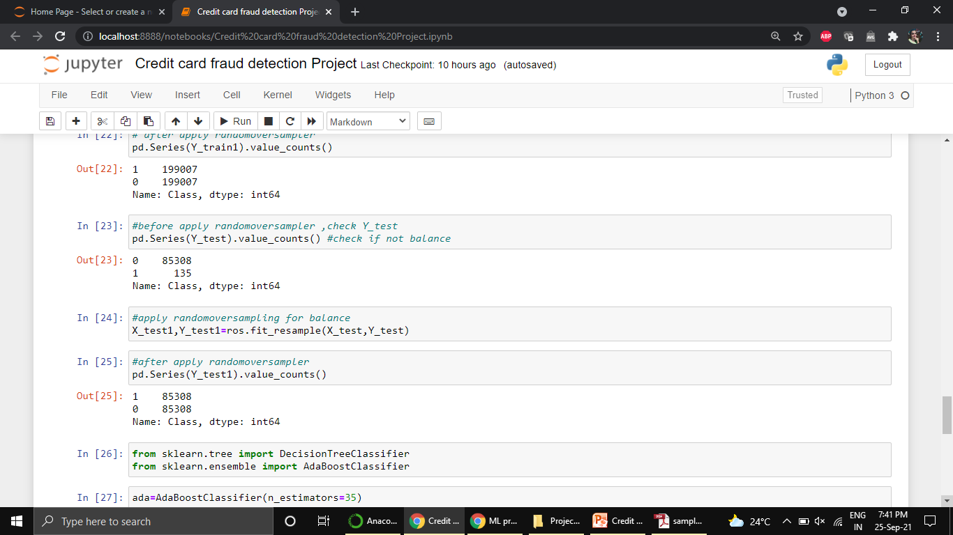
Sampling :
Sampling technique is used in classification problem where data is imbalance.
Here, over sampling is done to balance data.
Oversampling involves randomly selecting examples from the minority class, with replacement, and adding them to the training dataset.

Slide 12
Models | Accuracy
LOGISTIC REGRESSION | 62%
OVER SAMPLING + LOGISTIC REGRESSION | 87%
OVER SAMPLING + DTC | 68%
OVER SAMPLING + DTC + MAX_PRUNING | 82%
OVER SAMPLING + DTC + MIN_LEAF_SAMPLE | 81%
OVERSAMPLING + DTC + NAÏVE +HARD VOTING | 78%
OVERSAMPLING + DTC + NAÏVE +SOFT VOTING | 78%
OVERSAMPLING + BAGGING + LOGISTIC REGRESSION | 87%
OVERSAMPLING + BAGGING + DTC | 88%
OVERSAMPLING + PASTING+ LOGISTIC REGRESSION | 87%
OVERSAMPLING + PASTING+ DTC | 86%
OVERSAMPLING + RANDOM FOREST TREE | 79%
OVERSAMPLING + STACKING | 79%
ADA BOOST | 89%
GRADIENT BOOSTING | 87%
EXTREME GRADIENT BOOSTING | 81%
SVM LINEAR SEPERABLE DATA | 81%

Slide 13
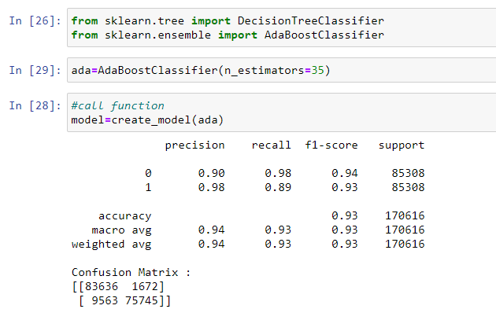
ADA Boost Model

Slide 14
CONCLUSION
As our aim is to reduce fraudulent transactions. We got the best recall and f1 score in ADA Boost model. Got 98% accuracy in predicting legit transactions and 89% accuracy in predicting fraudulent transactions.
Also, 94 % F1 score for legit and 93% F1 score for fraudulent, which is an excellent accuracy. Hence, considering ADA boost model for final deployment.
Followed by ADA Boost, Gradient boost, Extreme gradient boost, Bootstrapping and Random Forest Tree has also given good scores.

